Slide 1
Welcome to
CS 235 Data Structures
Self-balancing Trees (38)
Chapter 11.2 AVL, pgs. 628-643.

Slide 2
Attendance Quiz #37

Slide 3
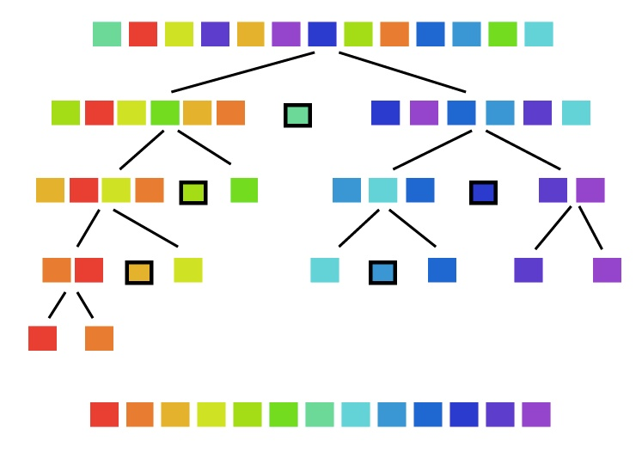
Lab 10 - Quicksort

Slide 4
Lab 10 - Quicksort
"Quicksort is a sorting algorithm developed by Tony Hoare that, on average, makes O(n log n) comparisons to sort n items. It is also known as partition-exchange sort.
In the worst case, Quicksort makes O(n²) comparisons, though this behavior is rare. Quicksort is typically faster in practice than other O(n log n) algorithms.
Additionally,
Quicksort's sequential and localized memory references work well with a cache.
Quicksort can be implemented as an in-place partitioning algorithm."

Slide 5
Lab 10 - Quicksort Commands
COMMAND | DESCRIPTION | OUTPUT
QuickSort <capacity> | Dynamically allocate a QuickSort array of size capacity. Set current number of elements (Size) to 0. | OK Error
AddToArray <data1> <data2>... | Add data element(s) to QuickSort array. Duplicates are allowed. Dynamically increase array size as needed (by doubling array capacity.) | OK Error
Capacity | Return the size of the QuickSort array. | size
Clear | Delete all nodes from the QuickSort array. | OK
Size | Return the number of elements currently in the QuickSort array. | elements
Sort <left> <right> | QuickSort the elements in the QuickSort array from index <left> to index <right> (where <right> is one past last element) using median and partition functions. | OK Error
SortAll | QuickSort all the elements in the QuickSort array using median and partition functions. | OK Error
MedianOfThree <left> <right> | 1) Calculate the middle index (middle = (left + right)/2), then 2) bubble-sort the values at the left, middle, and right indices. (<right> is one past last element.) | Pivot Index -1 error
Partition <left> <right> <pivot> | Using the revised pivot algorithm, partition the QuickSort array (<left>, <right> and <pivot> indexes) around the pivot value. Values smaller than the pivot should be placed to the left of the pivot while values larger than the pivot should be placed to the right of the pivot. (<right> is one past last element.) | Pivot Index -1 error
PrintArray | Print the contents of the QuickSort array as comma separated values (using a friend insertion (<<) operator and toString() function.) | Array values. Empty
Stats (Bonus) | Output the number of comparisons and exchanges used by the SortAll command. | Comparisons,Exchanges

Slide 6
L10 - Quicksort Example
QuickSort 2
AddToArray 1 6 5 4 2 8
PrintArray
Capacity
Size
Sort 0 3
PrintArray
AddToArray 7 -5 -1 -3 -2 -4
PrintArray
MedianOfThree 0 12
PrintArray
Partition 0 12 4
PrintArray
Size
SortAll
PrintArray
Stats
Clear
PrintArray
QuickSort 2 OK
AddToArray 1,6,5,4,2,8 OK
PrintArray 1,6,5,4,2,8
Capacity 8
Size 6
Sort 0,3 OK
PrintArray 1,5,6,4,2,8
AddToArray 7,-5,-1,-3,-2,-4 OK
PrintArray 1,5,6,4,2,8,7,-5,-1,-3,-2,-4
MedianOfThree 0,12 = 6
PrintArray -4,5,6,4,2,8,1,-5,-1,-3,-2,7
Partition 0,12,4 = 6
PrintArray 1,-2,-3,-1,-4,-5,2,8,4,6,5,7
Size 12
SortAll OK
PrintArray -5,-4,-3,-2,-1,1,2,4,5,6,7,8
Stats 53,22
Clear OK
PrintArray Empty

Slide 7
Common QuickSort Questions
Does the partition() function use medianOfThree() function?
What functions does the revised quick_sort() call?
What are error conditions of the partition() and medianOfThree() functions?
What is the difference between sort() and sortAll()?
How many comparisons/exchanges are there in medianOfThree() function?
No. The pivot index is the third argument.
The partition function begins by swapping the first and pivot (values).
medianOfThree.
partition QuickSort array using the pivot returned from medianOfThree.
quick_sort first to pivot.
quick_sort pivot+1 to last.
If the array is empty.
If either of the given integers is out of bounds,
If the left index is greater or equal to the right index.
Both call quick_sort.
sort() sorts the supplied range.
sortAll() sorts the entire QuickSort array (0 to size).
Always 3 comparisons and 0-3 exchanges.

Slide 8
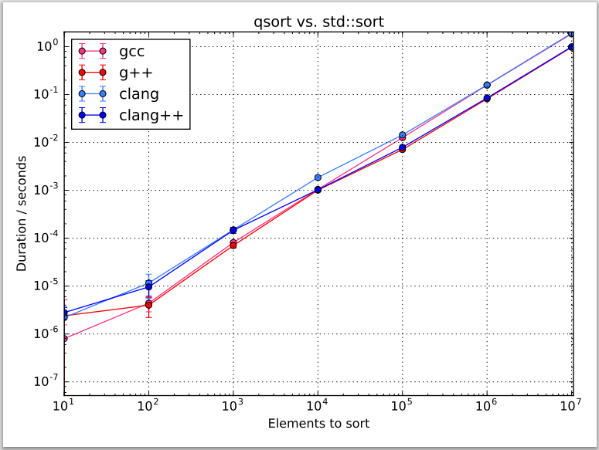
STL sort vs qsort
Which sorting algorithm is used in STL?
STL uses a hybrid of QuickSort, HeapSort and InsertionSort.
By default, it uses QuickSort but if QuickSort is doing unfair partitioning and taking more than n*log n time, it switches to HeapSort and when the array size becomes really small, it switches to InsertionSort.
Which sort is faster?
STL's sort rans faster than C's qsort because C++'s templates generate optimized code for a particular data type and a particular comparison function.

Slide 9
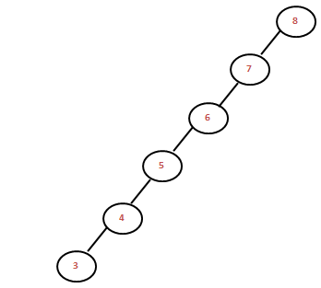
Chapter 11
Self-Balancing Search Trees
Chapter 11, pgs. 623-690

Slide 10
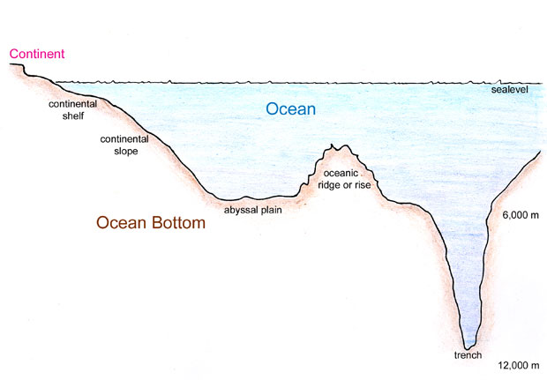
Tree Terminology Summary
Height = max(L_{c}Height, R_{c}Height) + 1
Height: 4
Depth: 0
Level: 1
Height: 2
Depth: 1
Level: 2
Height: 3
Depth: 1
Level: 2
Depth
Height
Height: 1
Depth: 2
Level: 3
Height: 1
Depth: 2
Level: 3
Height: 2
Depth: 2
Level: 3
Height: 1
Depth: 3
Level: 4
Root Node
Internal Node
Root node is depth 0
Leaf nodes are height 1
Leaf Node

Slide 11
Self-Balancing Search Trees
The performance of a binary search tree is proportional to the height of the tree or the maximum number of nodes along a path from the root to a leaf.
A full binary tree of height k can hold 2^{k} - 1 items.
If a binary search tree is full and contains n items, the expected performance is O(log n).
However, if a binary tree is not full, the actual performance is worse than expected.
To solve this problem, we introduce self-balancing trees to achieve a balance so that the heights of the right and left subtrees are equal (or nearly equal.)
Self-balancing trees include the AVL and Red-Black binary search trees, and non-binary search trees such as the B-tree and its specializations, the 2-3 and 2-3-4 trees, and the B+ tree.

Slide 12
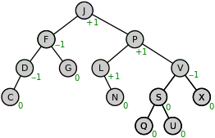
11.1 Tree Balance and Rotation
Why Balance Is Important
Rotation
Algorithm for Rotation
Implementing Rotation
11.1, pgs. 624-628

Slide 13
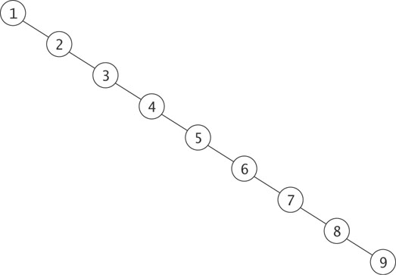
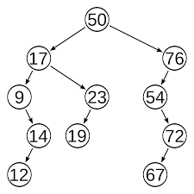
Why Balance is Important?
Searches into this unbalanced search tree are O(n), not O(log n).
A more realistic example of an unbalanced tree:
Worst case search should be 4
log₂(8 to 15) = 4
But is 5.

Slide 14
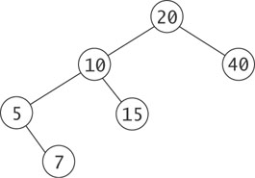
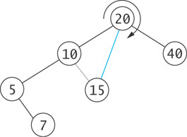
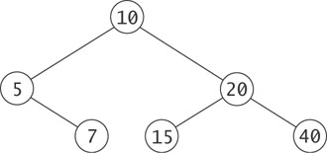
Rotation
A binary tree with n nodes (root, leaf, and internal nodes) and of height h is balanced if:
2^{(h − 1)} ≤ n < 2^{h}
Otherwise, it is unbalanced.
For example, a binary tree with height 4 can have between 8 and 15 nodes (between 1 and 8 leaf nodes) to be balanced.
We need an operation on a binary tree that changes the relative heights of left and right subtrees without interfering with the order of the elements.

Slide 15
Insert 20, 10, 40, 5, 15, then 7?
BTNode
root
20
root
= left
right =
data = 20
10
40
NULL
BTNode
NULL
BTNode
5
15
= left
right =
data = 10
= left
right =
data = 40
NULL
NULL
NULL
NULL
7
BTNode
BTNode
= left
right =
data = 5
= left
right =
data = 15
NULL
NULL
NULL
NULL
Node 20 is out of balance!
BalanceFactor = -2
Right rotate around 20
BTNode
= left
right =
data = 7
NULL
NULL

Slide 16
Algorithm for Right Rotation
BTNode
root
20
temp
root
= left
right =
data = 20
temp
10
40
NULL
BTNode
NULL
BTNode
5
15
= left
right =
data = 10
= left
right =
data = 40
NULL
NULL
NULL
NULL
7
BTNode
BTNode
= left
right =
data = 5
= left
right =
data = 15
NULL
NULL
NULL
NULL
BTNode
Remember value of root->left
(temp = root->left)
= left
right =
data = 7
NULL
NULL

Slide 17
Algorithm for Right Rotation
BTNode
root
20
temp
root
= left
right =
data = 20
temp
10
40
NULL
BTNode
NULL
BTNode
5
15
= left
right =
data = 10
= left
right =
data = 40
NULL
NULL
NULL
NULL
7
BTNode
BTNode
= left
right =
data = 5
= left
right =
data = 15
NULL
NULL
NULL
NULL
BTNode
Remember value of root->left
(temp = root->left)
Set root->left to value of temp->right
= left
right =
data = 7
NULL
NULL

Slide 18
Algorithm for Right Rotation
BTNode
root
20
temp
root
= left
right =
data = 20
temp
10
40
NULL
BTNode
NULL
BTNode
5
15
= left
right =
data = 10
= left
right =
data = 40
NULL
NULL
NULL
NULL
7
BTNode
BTNode
= left
right =
data = 5
= left
right =
data = 15
NULL
NULL
NULL
NULL
BTNode
Remember value of root->left
(temp = root->left)
Set root->left to value of temp->right
Set temp->right to root
= left
right =
data = 7
NULL
NULL

Slide 19
Algorithm for Right Rotation
BTNode
root
20
temp
root
= left
right =
data = 20
temp
10
40
NULL
BTNode
NULL
BTNode
5
15
= left
right =
data = 10
= left
right =
data = 40
NULL
NULL
NULL
NULL
7
BTNode
BTNode
= left
right =
data = 5
= left
right =
data = 15
NULL
NULL
NULL
NULL
BTNode
Remember value of root->left
(temp = root->left)
Set root->left to value of temp->right
Set temp->right to root
Set root to temp
= left
right =
data = 7
NULL
NULL

Slide 20
Algorithm for Right Rotation
root
BTNode
= left
right =
data = 10
NULL
BTNode
NULL
BTNode
= left
right =
data = 5
= left
right =
data = 20
NULL
BTNode
BTNode
BTNode
= left
right =
data = 7
= left
right =
data = 15
= left
right =
data = 40
NULL
NULL
NULL
NULL
NULL
NULL
root
root
20
10
Remember value of root->left
(temp = root->left)
Set root->left to value of temp->right
Set temp->right to root
Set root to temp
10
40
5
20
5
15
7
15
40
7

Slide 21
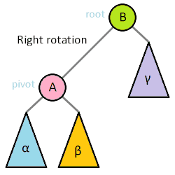
Algorithm for Right Rotation
root
BTNode
= left
right =
data = 10
BTNode
BTNode
= left
right =
data = 5
= left
right =
data = 20
NULL
BTNode
BTNode
BTNode
= left
right =
data = 7
= left
right =
data = 15
= left
right =
data = 40
NULL
NULL
NULL
NULL
NULL
NULL
Remember value of root->left
(temp = root->left)
Set root->left to value of temp->right
Set temp->right to root
Set root to temp

Slide 22
AVL Trees
In 1962 G.M. Adel'son-Vel'skiî and E.M. Landis developed a self-balancing tree, known by their initials: AVL.
The AVL tree algorithm keeps track of the difference in height of each subtree.
An AVL tree is balanced when the heights of all right and left subtrees are equal (or nearly equal.)
As items are added to (or removed from) a tree, the balance of each subtree from the insertion (or removal) point up to the root is updated.
BalanceFactor = height(right subtree) – height(left subtree)
The absolute difference between the left subtree and right subtree must not be > 1. If it becomes > 1, the subtree is rotated to make it ≤ 1 again.
A subtree is right-heavy if the balance factor > 0.
A subtree is left-heavy if the balance factor < 0.
A subtree is perfectly balanced if the balance factor = 0.

Slide 23
Balance Factor (Right - Left)
A node's "heaviness" is derived from its balance factor.
A subtree is right-heavy if the balance factor is greater than zero.
If the balance factor is less than zero then the subtree is left-heavy.
If the balance factor is zero then the subtree is perfectly in balance.
If a node's balance factor gets out of the range -1 to +1, the subtree is rotated according to its balance factor to bring it back into range.
Left-Left (parent balance is -2, left child balance is -1)
Rotate right around parent
Left-Right (parent balance -2, left child balance +1)
Rotate left around child
Rotate right around parent
Right-Right (parent balance +2, right child balance +1)
Rotate left around parent
Right-Left (parent balance +2, right child balance -1)
Rotate right around child
Rotate left around parent

Slide 24
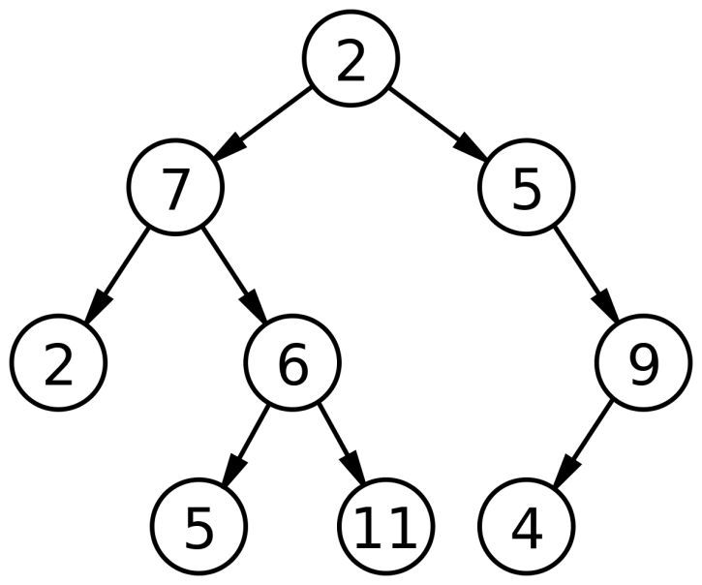
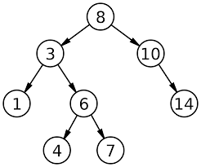
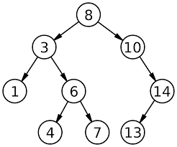
Which of these trees are 1) BST, 2) AVL, and 3) balanced trees? Why or why not?
Not BST, not AVL, Balanced
(3,1)
20
(2,1)
10
40
(0,1)
5
15
BST, not AVL, not Balanced
Balanced: 2^{(h − 1)} ≤ n < 2^{h}
AVL: |R_{h} – L_{h}| ≤ 1
7
(3,2)
(3,3)
(1,2)
(0,1)
(1,2)
(0,2)
(1,1)
(1,1)
(0,1)
BST, AVL, Balanced
BST, not AVL, Balanced

Slide 25
Be Safe

